Slide 1
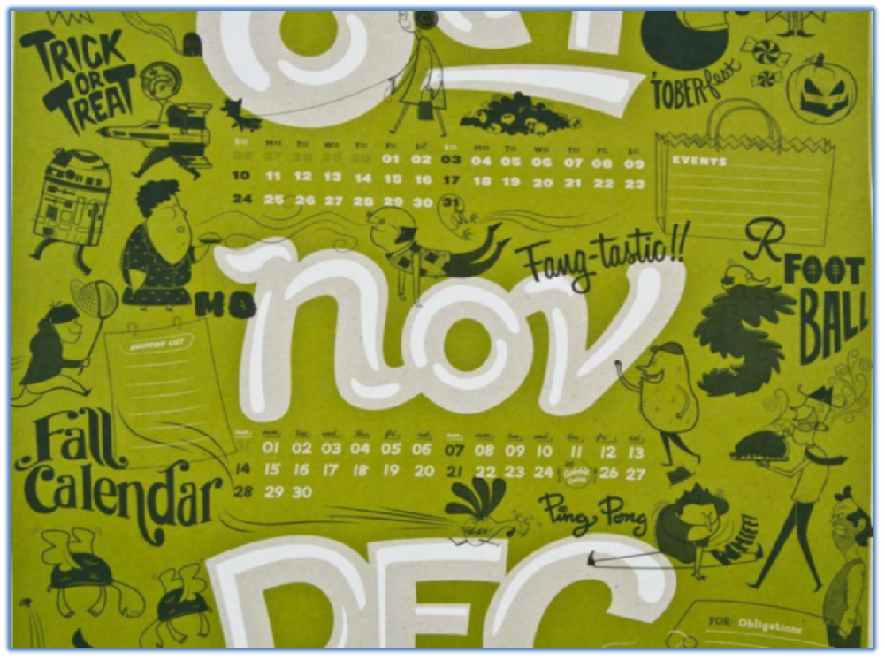

CALENDAR

Slide 2
I. Introduction
The Calendar which we currently follow is called the Gregorian Calendar. It is named after Pope Gregory XIII, who introduced it in October 1582.
The calendar was a refinement to the Julian calendar amounting to a. The motivation for the reform was to stop the drift of the calendar and set the date for Easter celebrations. Transition to the Gregorian calendar would restore the holiday to the time of the year in which it was celebrated when introduced by the early Church.
The reform was adopted initially by the Catholic countries of Europe. Protestants and Eastern Orthodox countries continued to use the traditional Julian calendar and adopted the Gregorian reform after a time, for the sake of convenience in international trade.
The last European country to adopt the reform was Greece, in 1923.

Slide 3
The Gregorian reform modified the Julian calendar's scheme of leap years as follows:
1. Every year that is exactly divisible by four is a leap year, except for years that are exactly divisible by 100, but these centurial years are leap years if they are exactly divisible by 400. For example, the years 1700, 1800, and 1900 are not leap years, but the years 1600 and 2000 are.
2. In addition to the change in the mean length of the calendar year from 365.25 days (365 days 6 hours) to 365.2425 days (365 days 5 hours 49 minutes 12 seconds

Slide 4
II. What are Ordinary and Leap years??
The time taken by the Earth to make one complete revolution is said to be a complete Year, which is equivalent to exactly
365.2425 days.
But ignoring the .2425 we generalize an ordinary year to be of 365 days.
Further for approximate calculation we assume the 365.2425 days to be 365.25 days.
This extra 0.25 days in 4 years becomes 1 full day. Hence that extra day is added to a year every 4 years. That particular year is called a leap year, which has one extra day than the ordinary year, which means a leap year has 366 days in total.

Slide 5
365.2425
365.24
365.25
0.0025 when ignored
0.24 approximated to 0.25 for simpler calculation
Only the 365
days taken
The 0.25 becomes 1 extra day in 4 years
Ordinary year
365 days
Leap year
=Ordinary year+(0.25x4)
=365+1
=366 days

Slide 6
How to check for a leap year?
Non Century Years:
If any non-century year (not ending with “00”) is divisible by 4 (last two digits of the year should be divisible by 4), then it is said to be a leap year.
Reason: As explained in the previous slide, the 0.25 extra days of 365.25 days become one extra day every 4 years (0.25x4=1).
Hence every 4 years we have one leap year.
Ex: 1844, 1892, 1996, 2004, 2012, 2016 etc

Slide 7
2. Century Years:
But in case of a century year(Years ending with “00”,ex: 1400,1600,2000,etc), the year will be a leap year only if it is divisible by 400.
Reason: 365.2425
365.25
Let us take an example. The 100th year is divisible by 4. But it is not a leap year.
Why???
The approximation we make while assuming 365.24 days to be 365.25 days (increasing the value by 0.01), leads to an extra 1 day which does not exist in real. Hence this extra 1 day which is forming every 100 year should be removed from the 100th year. So, although the hundredth year is divisible by 4 and should be a leap year, we remove that extra one day of the leap year from the 100th year. Hence it ends up as an ordinary year only.
But why is the 400th year a leap year then???

Slide 8
So, till now we learnt that the 100th year (Ex: 100,200,300 etc)is not a leap although it is divisible by 4.
But why is 400th year a leap year then???
This answer also lies in the value 365.2425 days which is the time taken by the earth for one revolution.
In 365.2425 we initially ignore 0.0025. which is a negligible value for one year. But in 400 years, this 0.0025 becomes 1 complete day (0.0025x4=1) and we add this extra day every 400th year.
Although like every 100th year, 400th year also should have been an ordinary year, but because of the addition of this extra day(mentioned above), every 400th year is a leap year.
And that is why every century leap year is divisible by 400.
Example: 400,1200,1600,2000 etc.

Slide 9
Let us take a quick quiz(Ask the students)
Q1. Is 1996 a leap year? Why?
Q2. Are all the years divisible by 4 leap years? Why?
Q3. How do you check for a century year, whether it is a leap year or not? Why?

Slide 10
III. Odd day concept
If we are supposed to find the day of the week on a given date, we use the concept of 'odd days'. In a given period, the number of days more than the complete weeks are called odd days .
For example the number of odd days in 15 total days = 1, since remainder when 15 is divided by 7 is 1.
Similarly the number of odd days in the month of January is 3. Since January has 31 days,
31/7= R(3).
Note: The odd day value will always lie from 0 to 6. If the odd day value is more than 6, keep dividing it by 7 until the remainder value comes below 7. The remainder value smaller than 7 is the final odd day value.

Slide 11
Finding odd days
1. In a single year
Now that you know what are odd days, can you find out how many odd days are there in an ordinary year and a leap year respectively???
1. Ordinary year:
Total no. of days=365 days
365/7= R(1)
Odd days = 1
2. Leap year:
Total number of days= 366
366/7= R(2)
Odd days= 2

Slide 12
Finding odd days
2. Through out a century/year span
Let us see through examples how to find the number of odd days through out a century or year span.
Ex: Find the number of odd days in the first 35 years in a century.
Step1: Let us first find the number of leap years and ordinary years in these 35 years. 35 years have 8 leap years (4x8=32, closest to 35).
Therefore no. of ordinary years= 35-8 = 27 years.
Step2: Odd days in 8 leap years= 8x2=16 (Since 1 leap year has 2 odd days)
Odd days in 27 ordinary years= 27x1=27 (Since 1 ordinary year has 1 odd day)
Step3: Total number of odd days=(16+27)=43= 43/7=R(1)
Therefore number of odd days in 35 years = 1

Slide 13
Following the same steps, find the number of odd days in the first century(first 100 years).
100
76
76
Total no. of odd days=(48+76)=124
124/7=R(5)
Hence, the first 100 years(century) have 5 odd days in total.
Note: The first 100 years have 24 leap years, not 25.
Because 100th year is not a leap year as discussed in slide no.8.
(No. of leap years)
(No. of ordinary years)
(Odd days in 24 leap years)
(Odd days in 76 ordinary years)

Slide 14
Odd days in the centuries
Since first 100 years is having 5 odd days, we can say:
First 200 years have 5x2=10, 10/7= R(3)
First 300 years have 5x3=15, 15/7= R(1)
First 400 years have 5x4=20, 20/7=R(6) + 1= 7= R(0)
And the cycle keeps repeating for the next centuries from here.
Note: 1 extra day has been repeated for 400 years, since 400th year is a leap year as mentioned in earlier slides.
Until Century | Up to Year | Odd days | Similar centuries
1st | 100 | 5 | 500 | >
2nd | 200 | 3 | 600 | >
3rd | 300 | 1 | 700 | >
4th | 400 | 0 | 800 | >

Slide 15
Odd days in the months
Month | No. of days | Odd days
January | 31 | 3
February | 28,29 | 0,1
March | 31 | 3
April | 30 | 2
May | 31 | 3
June | 30 | 2
July | 31 | 3
August | 31 | 3
September | 30 | 2
October | 31 | 3
November | 30 | 2
December | 31 | 3

Slide 16
Concept Review Question
Q. If May 10, 1997 was a Monday, what will be the day on Oct 10, 2001?
Wednesday
Thursday
Friday
Saturday

Slide 17
Solution:
In this question the reference point is May 10, 1997 and we have to find the number of odd days from May 10, 1997 up to Oct 10, 2001.
Now, from May 11, 1997 - May 10, 1998 = 1 odd day
May 11, 1998 - May 10, 1999 = 1 odd day
May 11, 1999 - May 10, 2000 = 2 odd days (2000 was leap year)
May 11, 2000 - May 10, 2001 = 1 odd day
Thus, the total number of odd days up to May 10, 2001 = 5.
Now, the remaining 21 days of May will give 0 odd days.
In June, we have 2 odd days; in July, 3 odd days; in August, 3 odd days; in September,2 odd days and up to 10th October, we have 3 odd days. Hence, total number of odd days = 18 i.e. 4 odd days.
Since, May 10, 1997 was a Monday, then 4 days after Monday will be Friday. So, Oct 10, 2001 would be a Friday.

Slide 20
IV. 1. a) Finding the day for a particular date
Odd days in the year(Actual year-1)
Odd days in the month(Actual month-1)
Odd days in the date
Get the sum of the odd days and the final odd day value from it.
Ex: 15/07/2016
Odd days in 2015
Odd days in January to June
Odd days in the date(15/7= R(1))
Sum/7=Odd day value
Odd day value | 1 | 2 | 3 | 4 | 5 | 6 | 7 or 0
Day of the week | Mon | Tue | Wed | Thu | Fri | Sat | Sun

Slide 21
Concept review Questions:
Using the above mentioned conventional method, find the day for the following dates:
Independence day of India
Republic Day of India

Slide 22
Example:
Find the year which as same calendar as that of 2007 after it.
Sol:
Given year is 2007
According to the above above Rule:
2007 is at the 3rd position. So add 11 yr
2007+11=2018
so the same Calendar after 2007 is 2018.
LY | 1ST | 2ND | 3RD | LY
28 | 6 | 11 | 11 | 28

Slide 23
Concept Review Question
Find the year after 2015 which has the same calendar as 2015.
2019
2023
2026
2029
Ans: C

Slide 24
Concept Review Question
The year after 1996 having the same calendar as of 1996 will be
1999
1998
2001
None of these
Ans: D

Slide 25
PRACTICE QUESTION

Slide 26
Q1. If today is Monday, what will be the day one year and 50 days from now? (Tech Mahindra-2011)
Tuesday
Wednesday
Thursday
Can not be determined

Slide 27
Q2. Bunny, brother of Sunny is 568 days older to him while his sister Jenny is 75 weeks older to him. If Jenny was born on Tuesday, on which day was Bunny born? (Tech Mahindra-2015)
a) Monday
b) Tuesday
c) Friday
d) Saturday
e) Thursday

Slide 28
Q3. If day before Yesterday it was Monday, What day will fall on day after tomorrow ? (Tech Mahindra-2013)
a. Sunday
b. Tuesday
c. Saturday
d. Friday

Slide 29
Q4. Radha remembers that her father's birthday is after 16th but before 21st of March, While her brother Mangesh remembers that his father,s birthday is before 22nd but after 19th of March. On which date is the birthday of their father?
(Tech Mahindra-2015)
a) 19th
b) 20th
c) 21st
d) Cannot be determined
e) None of these

Slide 30
Q5. 1.12.91 is the first Sunday. Which is the fourth Tuesday of December 91?
(TCS-2015)
31.12.91
(b) 24.12.91
(c) 17.12.91
(d) 26.12.91

Slide 31
Q6. If the third day of the month is Monday, Which of the following will be the fifth day from 21st of that month? (Tech Mahindra-2015)
a) Tuesday
b) Monday
c) Wednesday
d) Thursday
e) None of these

Slide 32
Q7. If 8th Dec, 2007 was Saturday then what day of the week was it on 8th Dec, 2006? (Capegemini-2015)
Monday
(b) Thursday
(c) Friday
(d) Sunday

Slide 33
Q8. Two brothers were expected to return here on the same day. Rajat returned 3 days earlier but Rohit returned 4 days later. If Rajat returned on Thursday, what was the expected day when both the brothers were to return home and when did Rohit Return?(Infosys 2015)
a) Wednesday, Sunday
b) Thursday, Monday
c) Sunday, Thursday
d) Monday, Friday

Slide 34
Q9. 8th Dec 2009 was Tuesday, what day of the week was it on 8th Dec, 2006? (SSC,2016)
A. Sunday
B. Tuesday
C. Friday
D. Tuesday

Slide 35
Q10. Miley went to party nine days ago. She goes to party only on Thursday. What day of the week is today? (Tech Mahindra-2013,2015)
a) Sunday
b) Tuesday
c) Thursday
d) Saturday
e) Friday

Slide 36
Q11. What was the day of the week on January 1, 1998? (Tech Mahindra-2016)
a. Wednesday
b. Monday
c. Friday
d. Thursday

Slide 37
Q12. What was the day of the week on December 26,1995? (Tech Mahindra-2015)
a) Friday
b) Tuesday
c) Sunday
d) Monday
e) None of the above

Slide 38
Q13. The day of week on July 1,2000 was
(Tech Mahindra-2014)
a) Monday
b) Friday
c) Saturday
d) Tuesday
e) None of the above

Slide 39
Q14. On what dates of August 1980 did Monday fall? (TCS-2014)
4th, 11th, 18th, 25th
3rd, 10th, 17th, 24th
6th, 13th, 20th, 27th
9th, 16th, 23rd, 30th

Slide 40
Q15. If we suppose the 60th independence day of India was on Thursday, then the 85th independence day would have been on?
Monday
Wednesday
Friday
Sunday

Slide 41
Q16. If 1 Jan 2015 is Thursday then probability of 22nd October to be Wednesday will be? (Infosys-2015)
0
0.5
1
Can not be determined

Slide 42
Q17. The calendar for 1992 is the same as for (Tech Mahindra-2012,2015)
a) 1997
b) 2020
c) 2016
d) 1994

Slide 43
Q18. The calendar of year 1982 is same as which year?
1988
1990
1992
1993

Slide 44
Q19. How many times the 29th day of the month does occur in 400 consecutive years? (Cognizant-2013)
4500
4498
4497
4495

Slide 45
Q20. John was born on Feb 29th of 2012 which happened to be a Wednesday. If he lives to be 101 years old, how many birthdays would he celebrate on a Wednesday?
3
4
5
1

Slide 46
Q21. History Professor Nagarajan was talking to the students about a century which has started with a Monday. What day India would be witnessing on the last day of the century, the Professor was posing a question. Incidentally he posed a question that the last day of the century cannot be:
(a)Monday (b) Tuesday
(c)Wednesday (d) Friday
Can you answer the Professor ‘s question?

